Slide 1
The Carbonara Project.
The front window of malware research.

Slide 2
Programs are made of functions.
A
B
C
foo.c
Notes:
What is a malware
To understand analyze each function
Lots of functions

Slide 3




Malwares reuse functions.
foo.c
bar.c
A
A
B
D
C
C
Notes:
Already know what older do
Concentrate only on newer

Slide 4
Malware analysis is time-sensitive
Source: trend micro research
Notes:
Costs exponential related to time

Slide 5
Source: BI Intelligence, 2015
The costs are huge.
Notes:
Not talking about little money

Slide 6
Time is an issue
We’ve surveyed 50 malware analysts
Notes:
Is time the main concern

Slide 7

Our solution
Keep a database of functions and analyses made by the users.
push rbp
mov rbp, rsp
mov rbx, rbp
carbonara-project.github.io
Notes:
Leverage previous knowledge

Slide 8
Reverse engineering tools.
A shared database of malwares and reports.
We aim at creating an environment
for the cyber security community to thrive.
Community.
Share, comment, discuss.
Notes:
Tools to exploit this knowledge
DB to keep work done by analysts
Seamlessly cooperate

Slide 9
Roadmap
Machine
Learning
model
Binary
analysis
Idea
validation
Procedure
matching
User
validation
1
2
3
User
creation
Google
auth
Users
feedback

Slide 10
What’s ahead
Augment
predictive model
Increase users
interaction
Add new analyses
tools

Slide 11

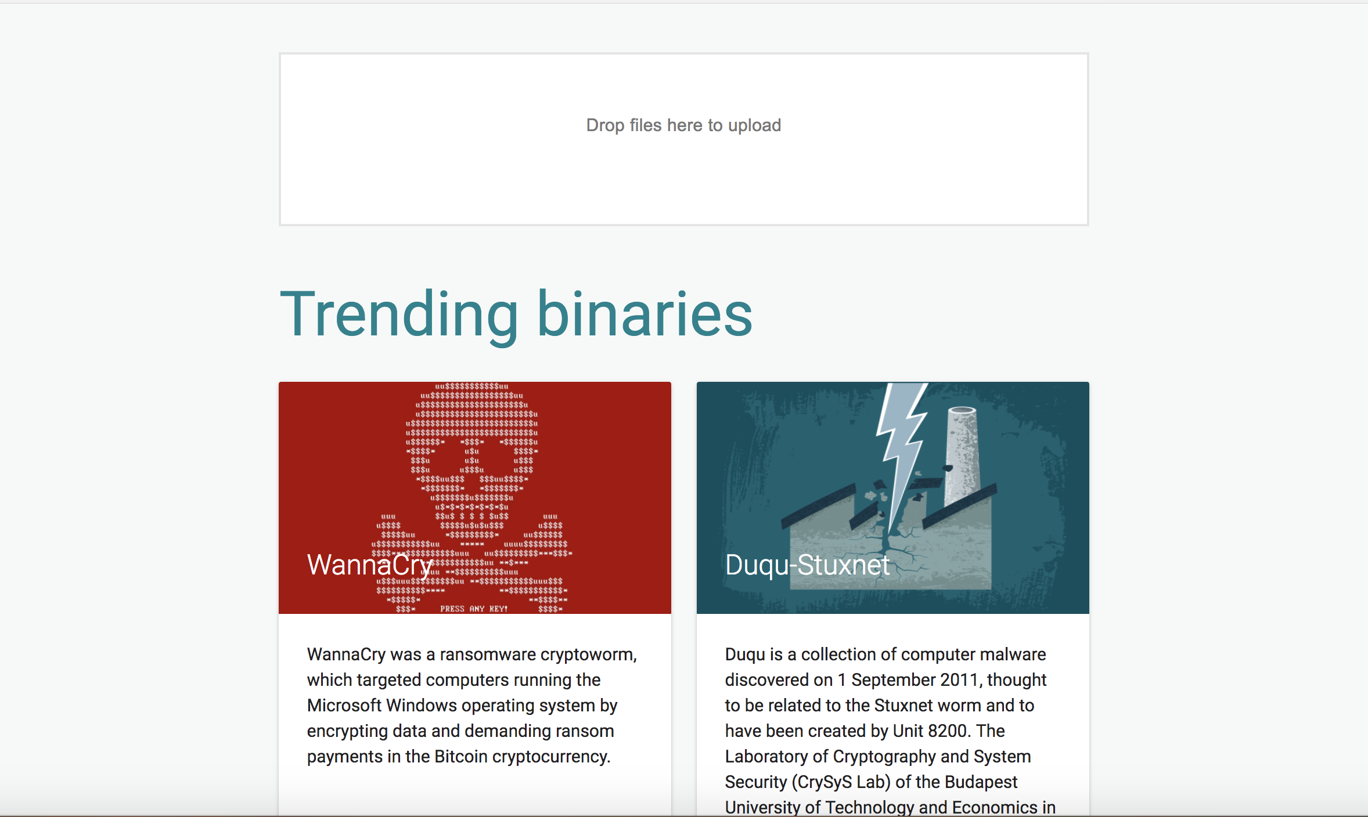

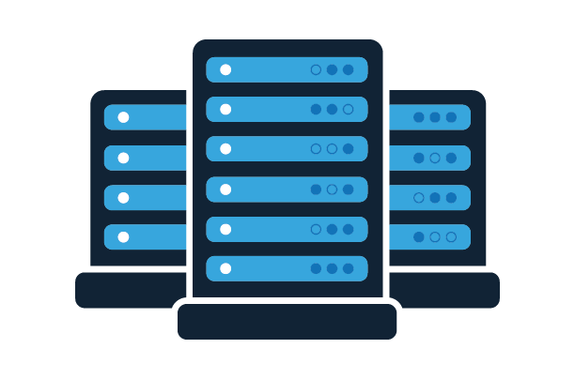
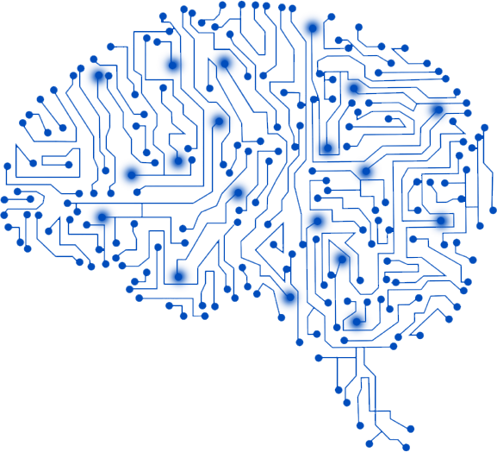
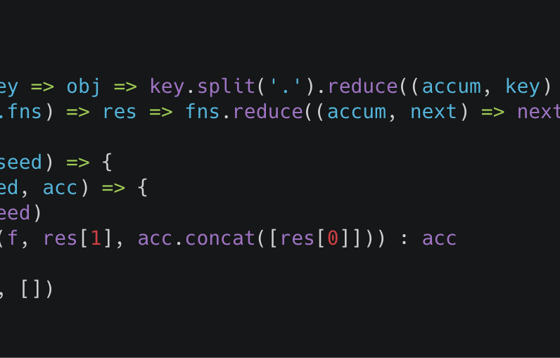
Frontend
Analysis Cluster
Main Server
Command Line
Interface
Machine Learning
Engine
Notes:
Overall architecture

Slide 12
Project challenges
Find quality data
Organize team work
Smooth users interactions

Slide 13
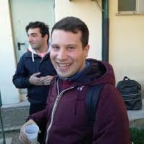

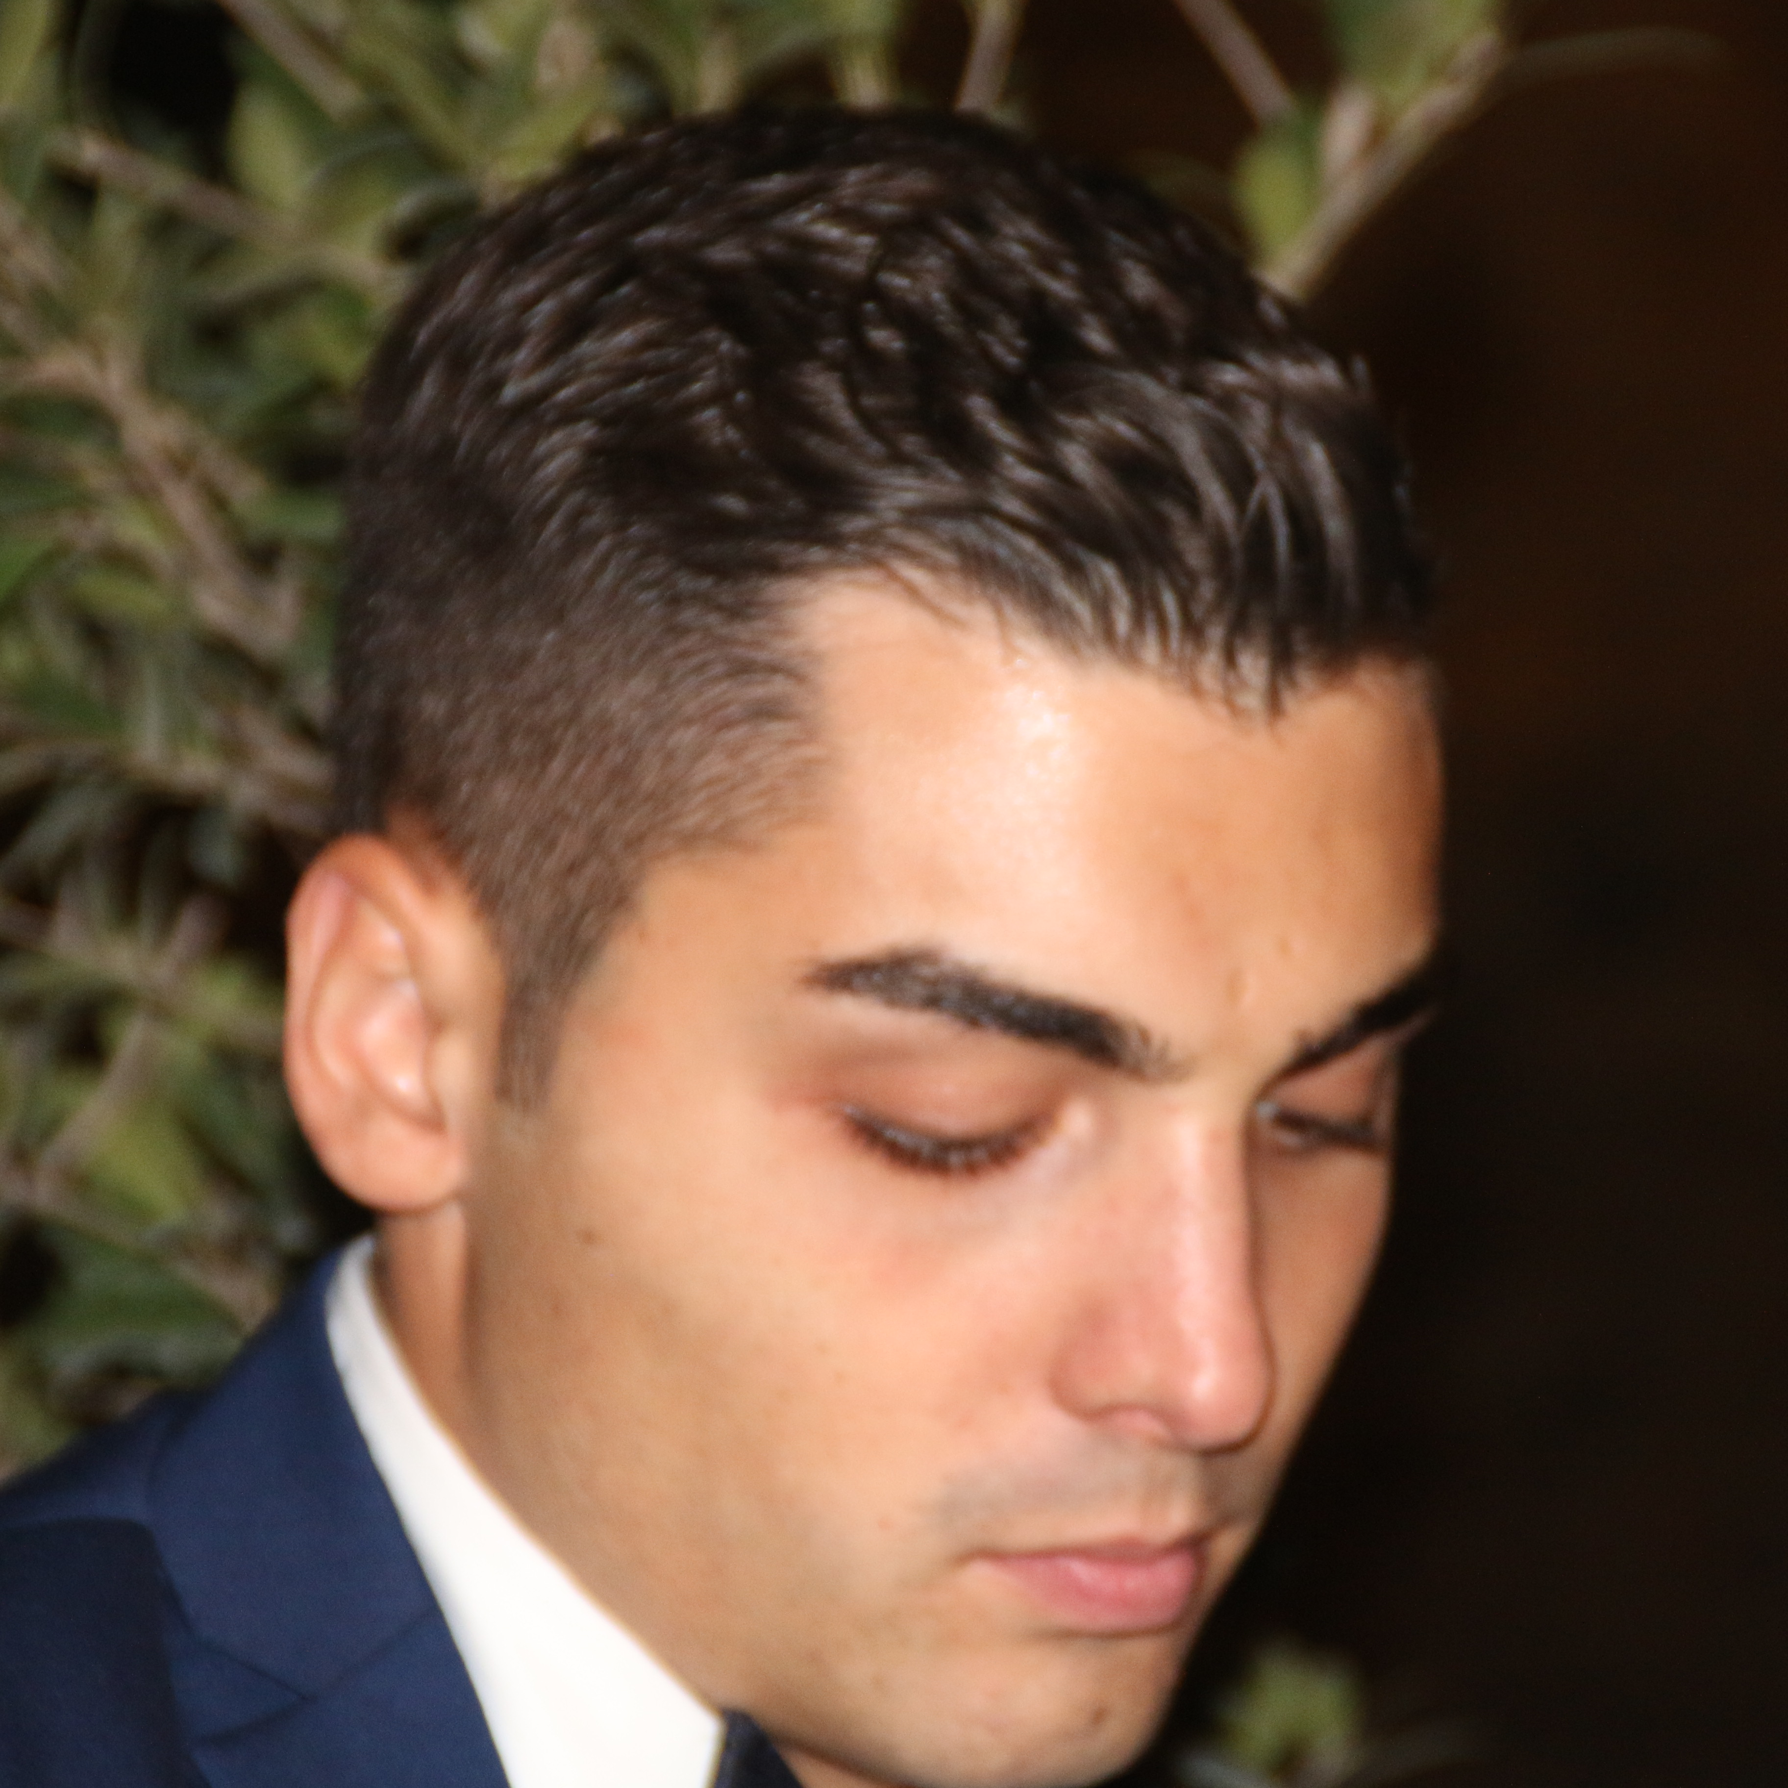


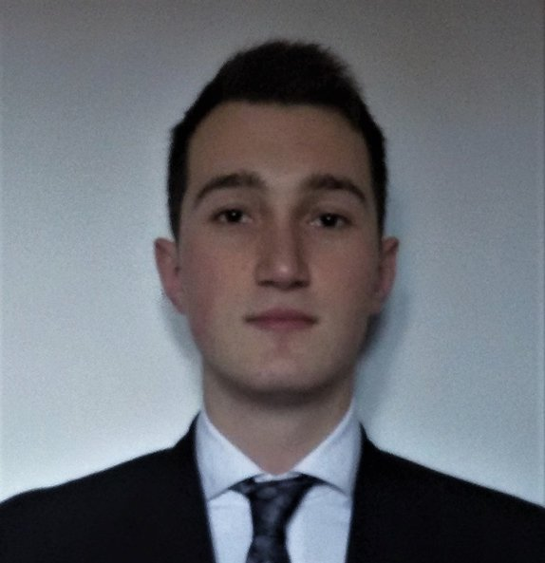
Our team
Software engineer
Andrea Fioraldi
Software engineer
Luigi Paolo Pileggi
Software engineer
Daniele Paliotta
We are part of the Cyber Security Competition team
TheRomanXpl0it (Top 10 in the world)
Back-end engineer
Luca Ferrera
Back-end engineer
Andrea Tulimiero
Front-end developer
Daniele Cappuccio

Slide 14
Installation guide
https://github.com/Carbonara-Project/Carbonara-CLI/blob/master/README.md
Landing page
https://carbonara-project.github.io/
Whitepaper
https://carbonara-project.github.io/Carbonaraproject_paper.pdf
Web app
https://carbonaraproject.com

